Slide 1
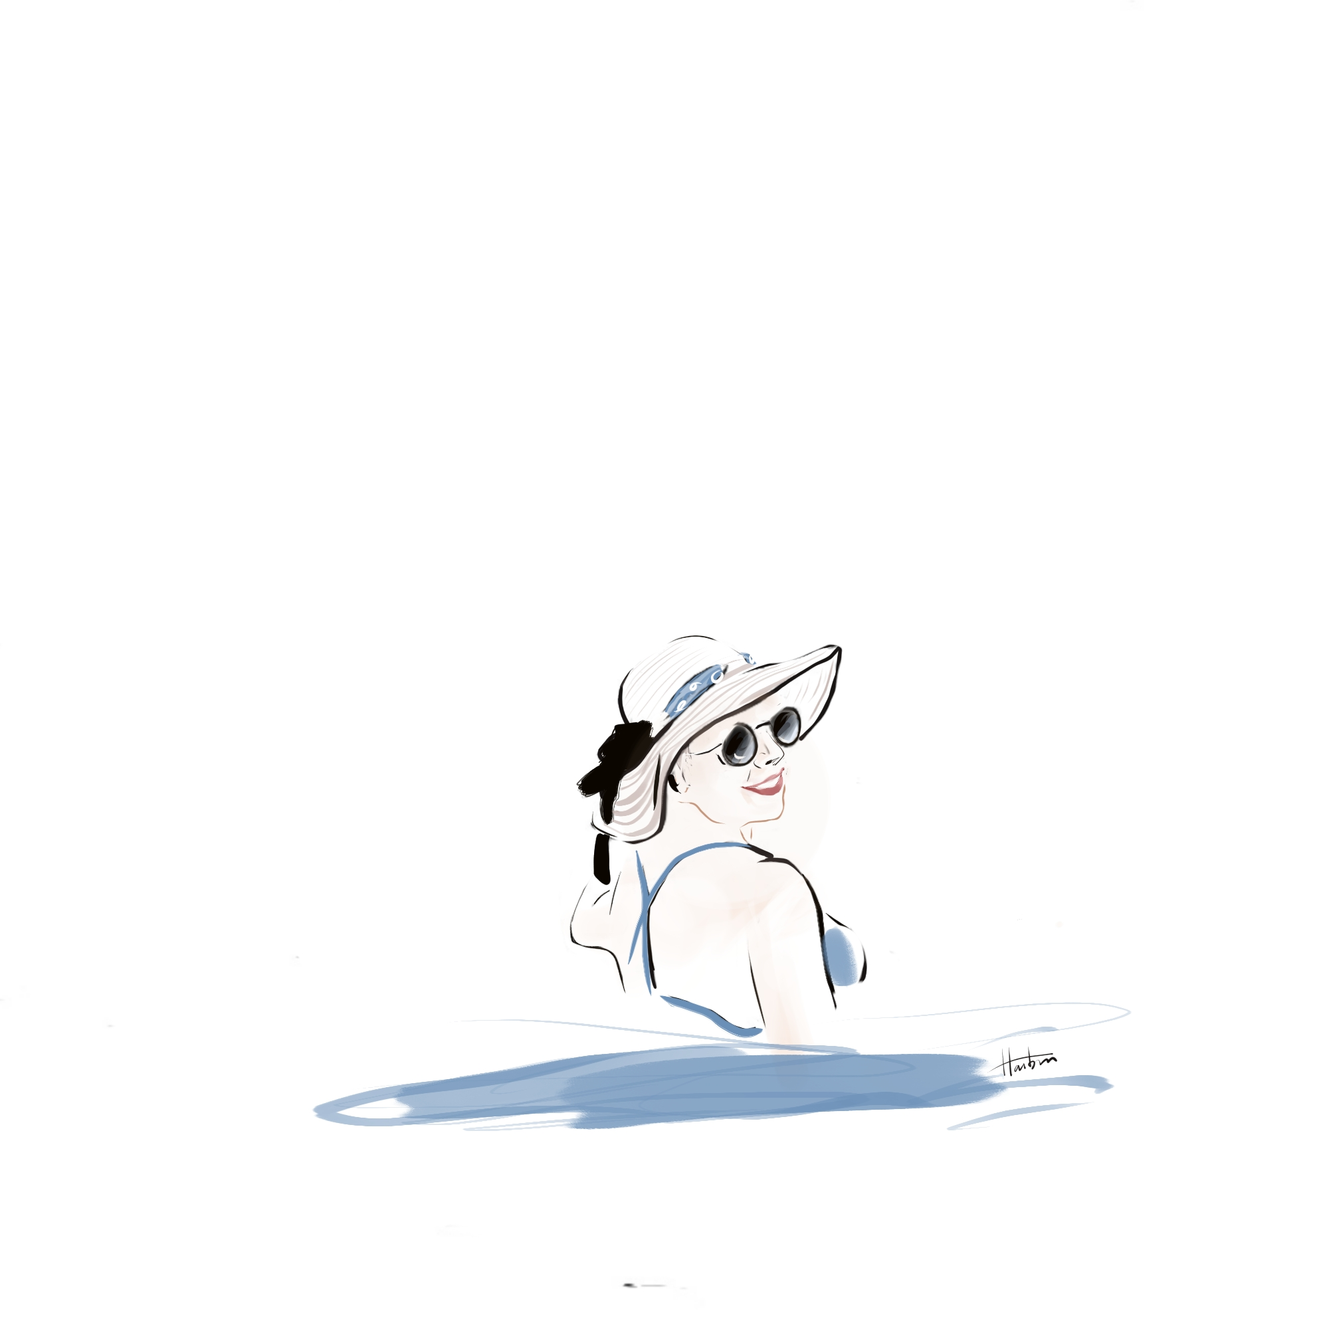
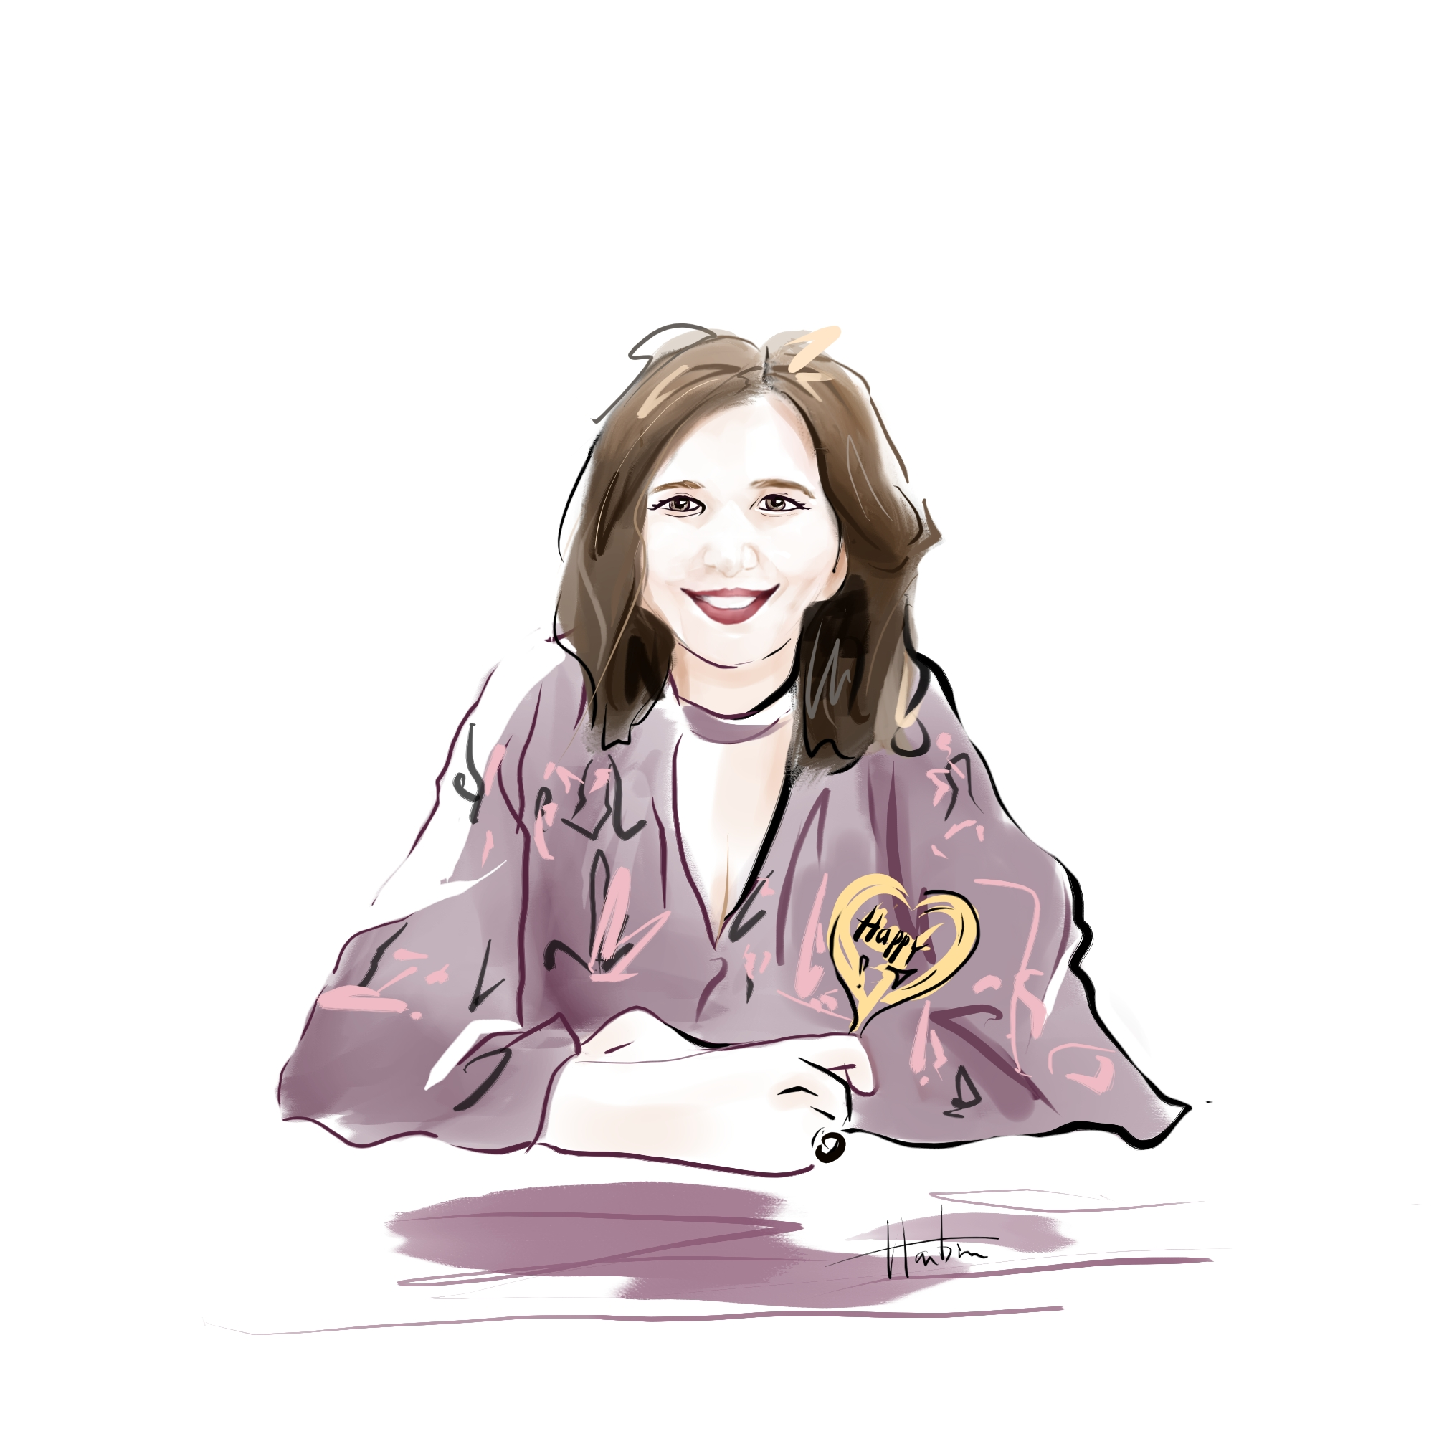
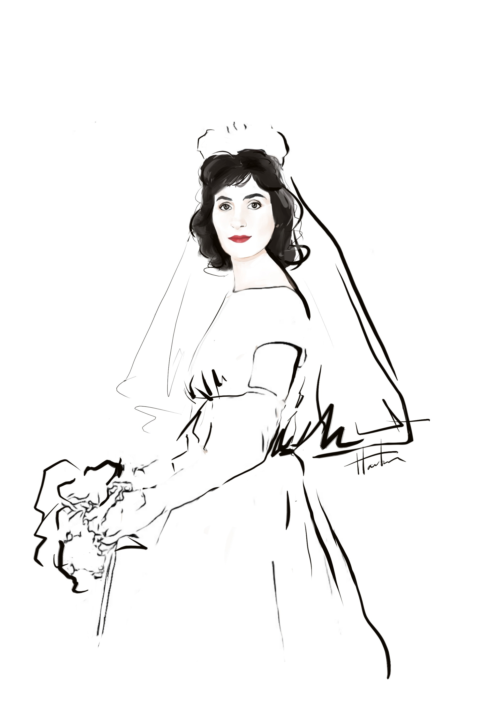
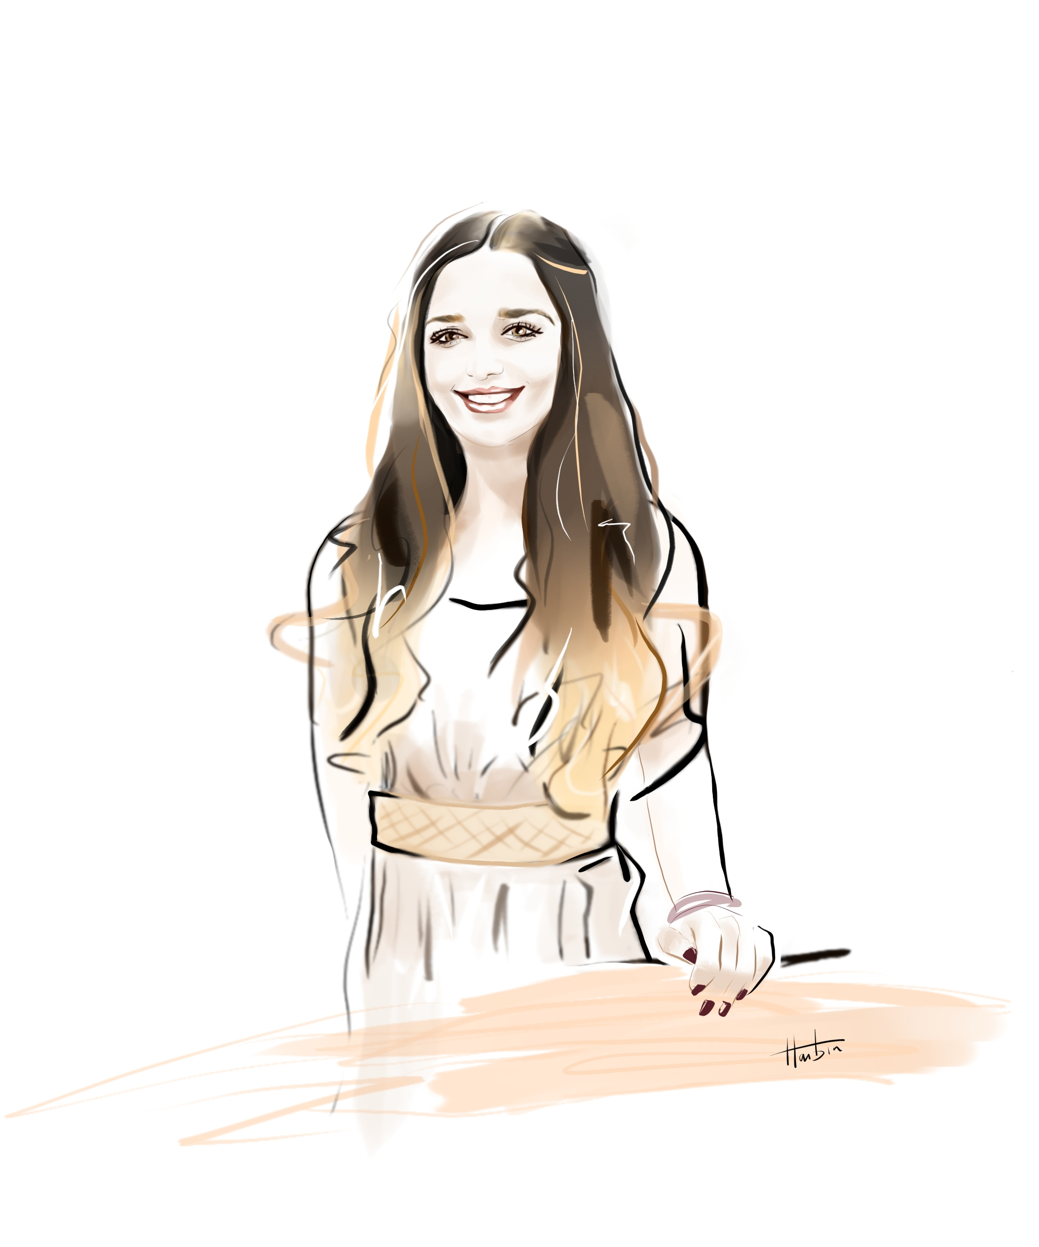
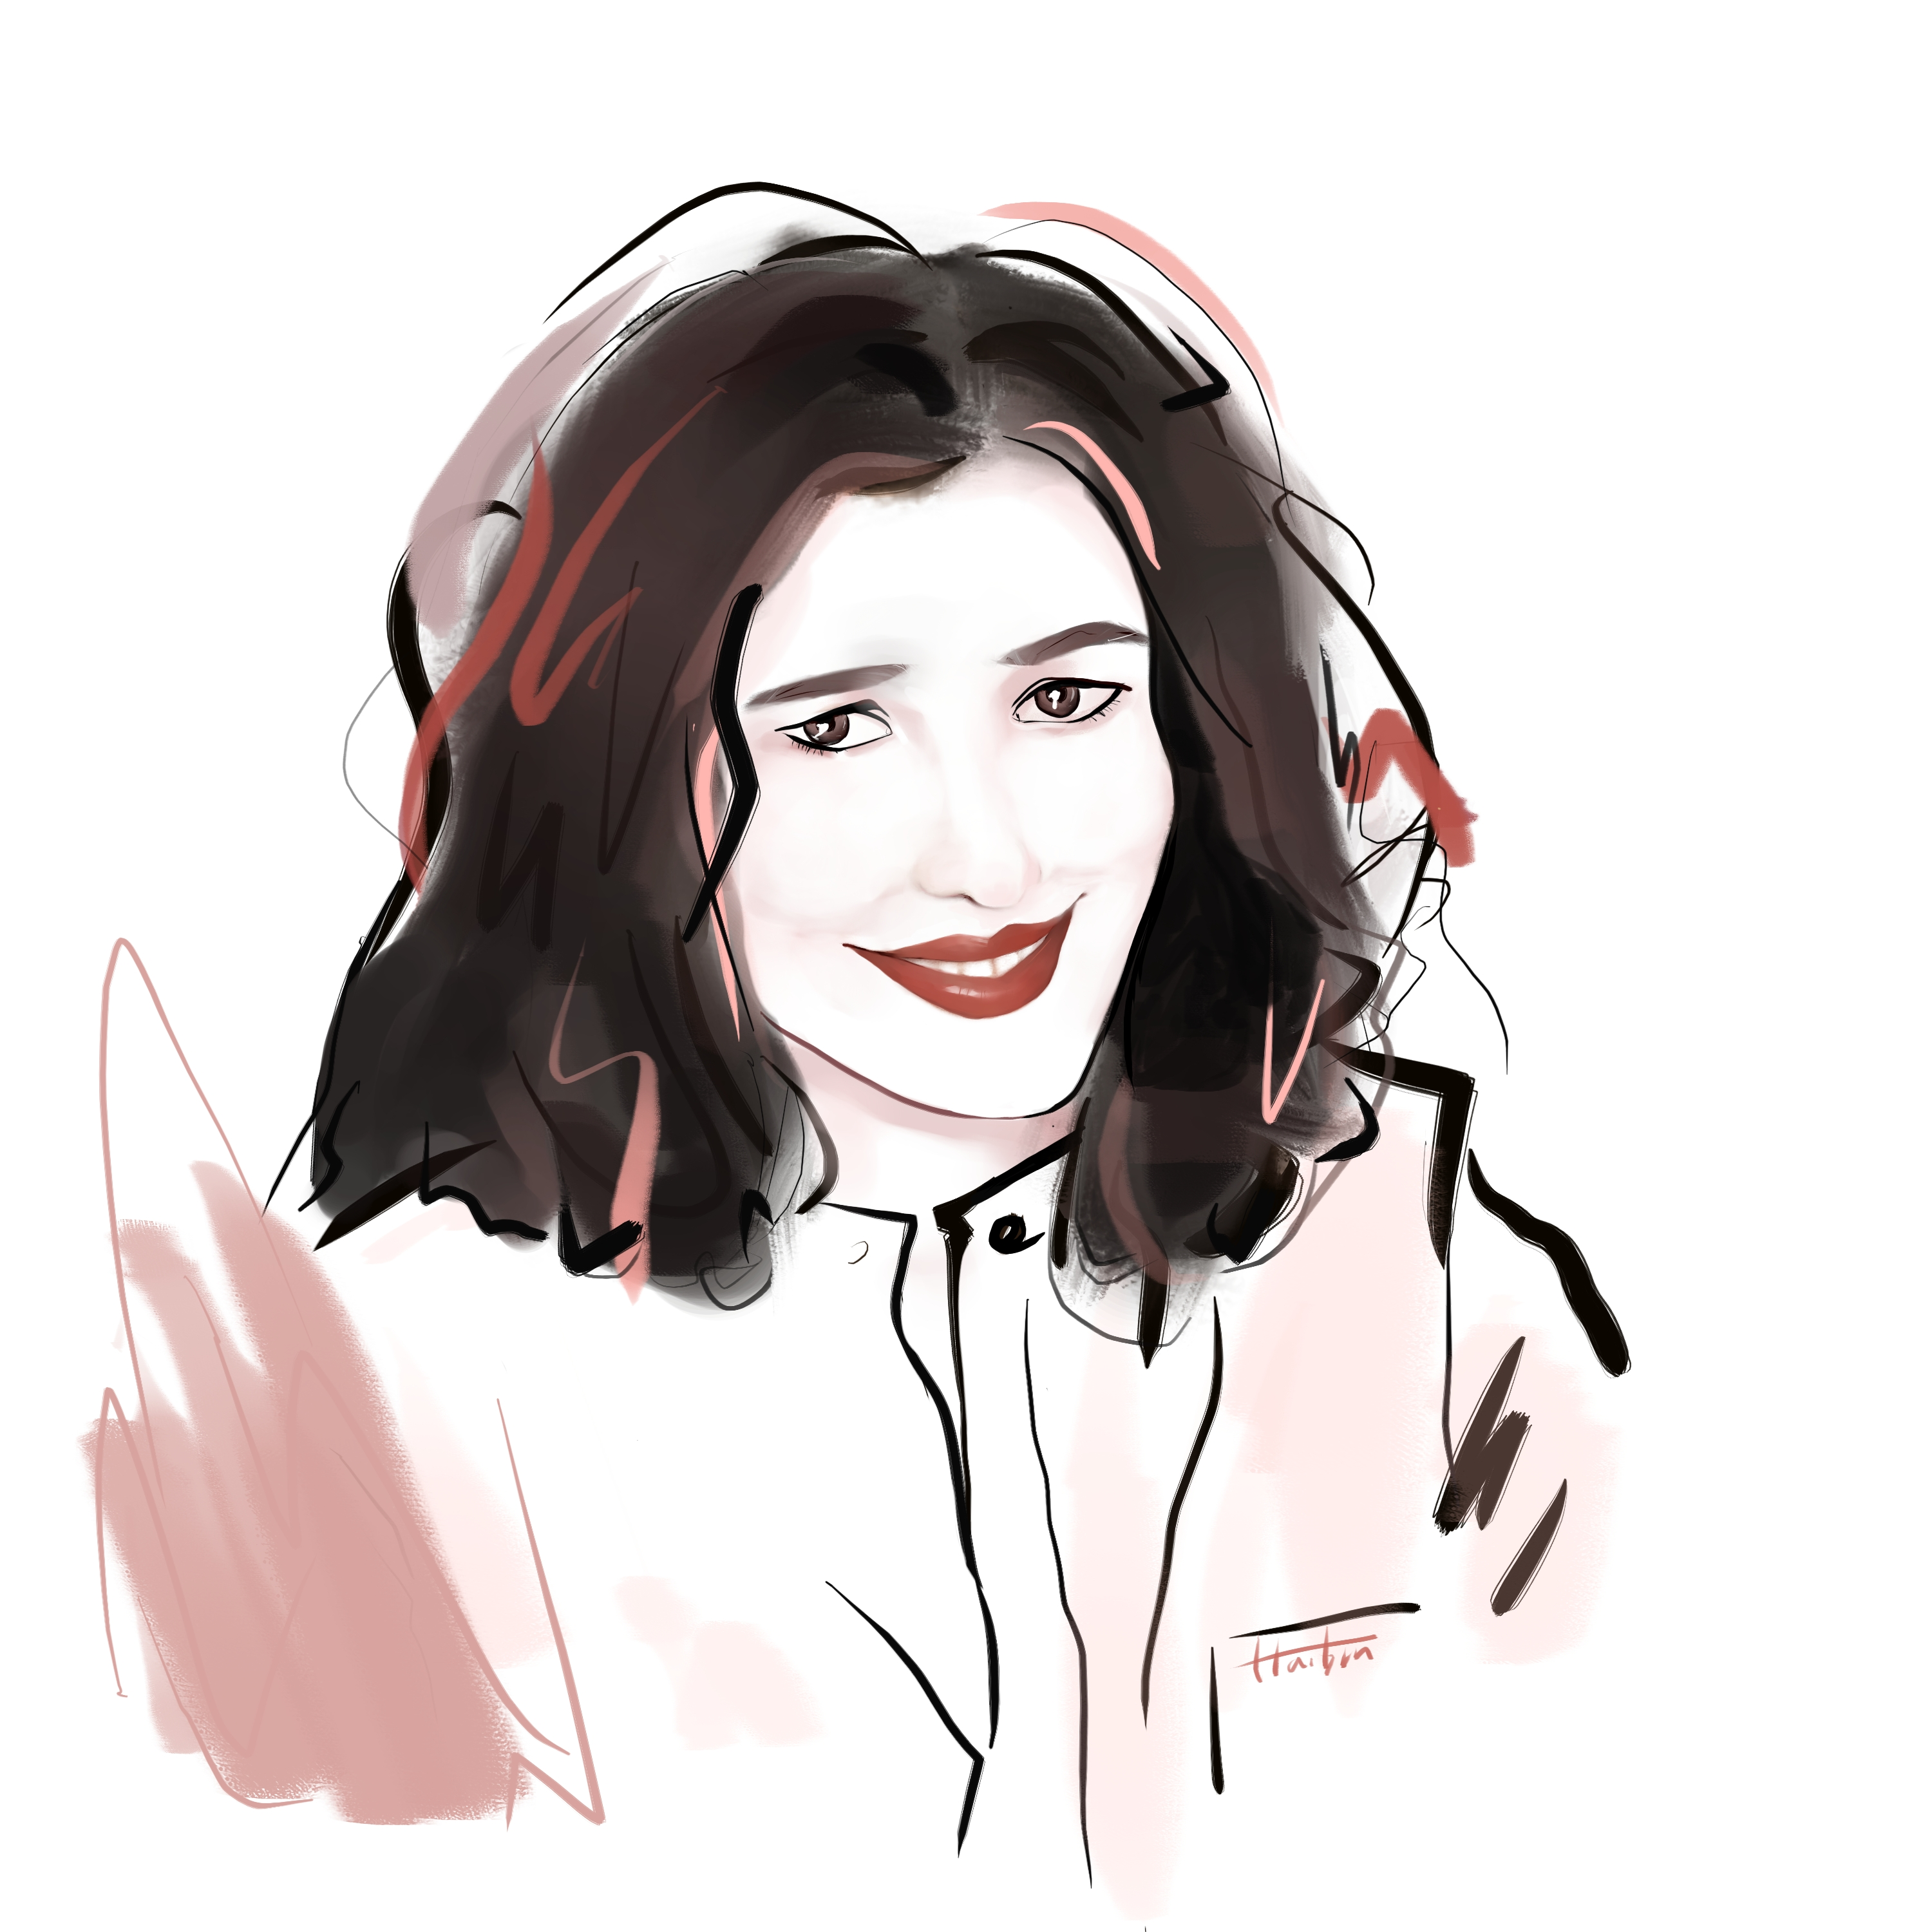

Slide 2
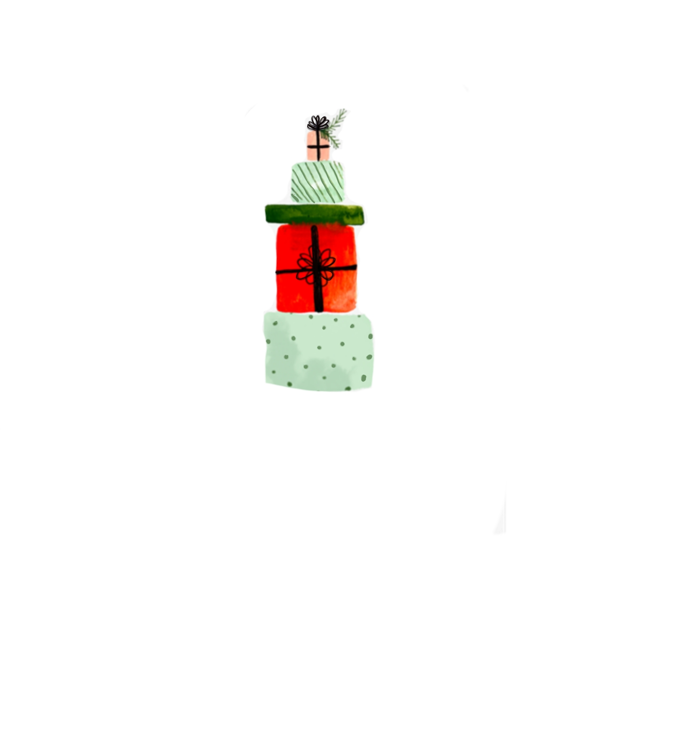

¡Feliz Navidad y próspero Año Nuevo!
Te deseo mucha alegría y felicidad estas fiestas.
Peter & Haibin

Slide 3
Happy Birthday! Sending Season’s greetings to you this Christmas. Wishes for health, happiness and love this Holiday Season!
Peter & Haibin

Slide 4
Well, that was a crazy year! Hope your holidays are full of health, joy and all the things you wished for.
Peter & Haibin

Slide 5
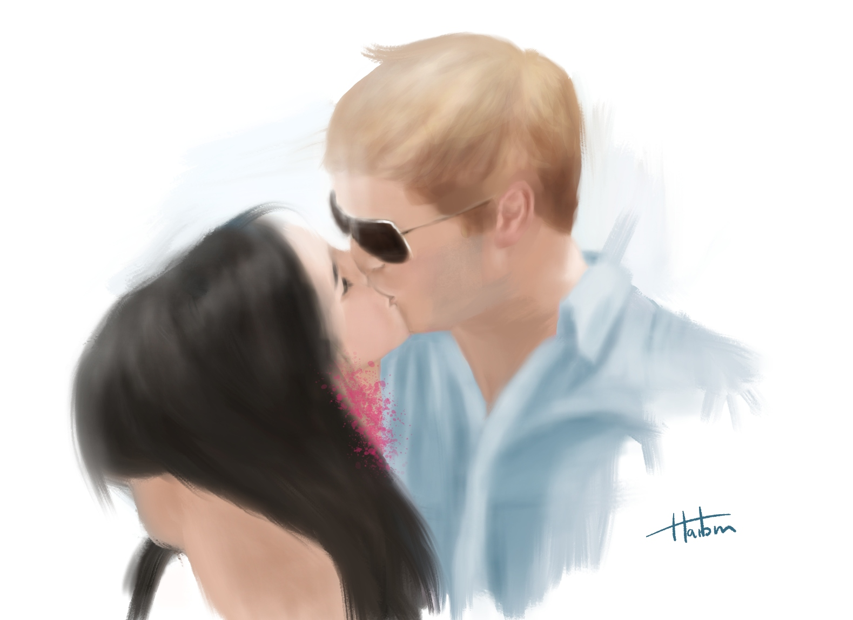
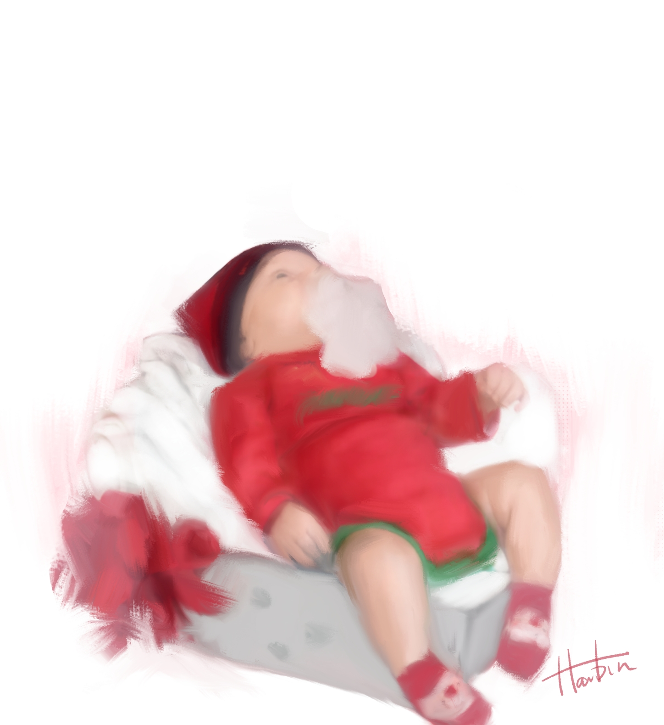
Sending love and holiday wishes from our bubble to yours (We wished for a better New Year!)
Peter & Haibin

Slide 6
New Year? Yes Please! Here’s to better times ahead for everyone. Stay healthy & take care. We miss you!
Peter & Haibin

Slide 7
May your holiday season be merry and bright. Sending all our love and wishes for better days ahead and a quarantine-free New Year.
Peter & Haibin

Slide 8
Well, that was a crazy year! Hope your holidays are full of health, joy and all the things you wished for.
Peter & Haibin

Slide 9
New Year? Yes Please! Here’s to better times ahead for everyone. Stay healthy & take care. We miss you!
Peter & Haibin

Slide 10
Sending love and holiday wishes from our bubble to yours (We wished for a better New Year!)
Peter & Haibin

Slide 11
Happy Birthday! Sending Season’s greetings to you this Christmas. Wishes for health, happiness and love this Holiday Season!
Peter & Haibin

Slide 12
May your holiday season be merry and bright. Sending all our love and wishes for better days ahead and a quarantine-free New Year.
Peter & Haibin

Slide 13
¡Feliz Navidad y próspero Año Nuevo!
Te deseo mucha alegría y felicidad estas fiestas.
Peter & Haibin

